Slide 1

PROJECT PHASE -2 (DEMO) Developing a robot car that is capable of delivering items within the campus
BALLARI INSTITUTE OF TECHNOLOGY AND MANAGEMENT
DEPARTMENT OF COMPUTER SCIENCE AND ENGINEERING
Guide :
Mr. VIRUPAKSHA GOUDA CSE, BITM Ballari
PRESENTED BY
Mohammed Ali Usn: 3BR21CS406
Mandeep Singh Usn: 3BR21CS405
Mohammed Irshaq Usn: 3BR21CS407
Aishwarya V Usn: 3BR21CS400
Co-Ordinator :
Dr. PANIRAM PRASAD
CSE, BITM Ballari
1

Slide 2

project aims to provide a unique solution to the problem of delivering packages and any other items on a college campus. The project is a collaborative effort between the university and a group of students who are passionate about robotics and automation. The goal of this project is to create an autonomous delivery bot that can navigate the campus and deliver packages and items to designated locations.
The project aims to reduce the workload of delivery personnel and improve the efficiency of the delivery process.
The project also aims to provide a unique learning opportunity for students interested in robotics and automation

Slide 3
Vision & Mission :
Vision
To revolutionize the on-campus delivery experience by providing a fast, reliable, and efficient service that meets the needs of students and staff.
Mission
To design and develop an autonomous delivery bot that is capable of navigating through a busy campus environment and delivering packages to designated locations in a timely and secure manner.

Slide 4
Objectives :
To enhance overall operational efficiency by optimizing delivery routes, reduce waiting times, and improve accuracy.
To optimize the performance of the car in line following mode for efficient and accurate deliveries on predefined routes.
To implement obstacle detection mechanism and develop avoidance strategies to navigate around obstacles safely and effectively in obstacle avoidance mode.
To determine and optimize the car's payload capacity, ensuring it can handle a variety of delivery items while maintaining its efficiency.
To enhance the car's energy efficiency and optimize battery life to support longer delivery routes in various modes.

Slide 5
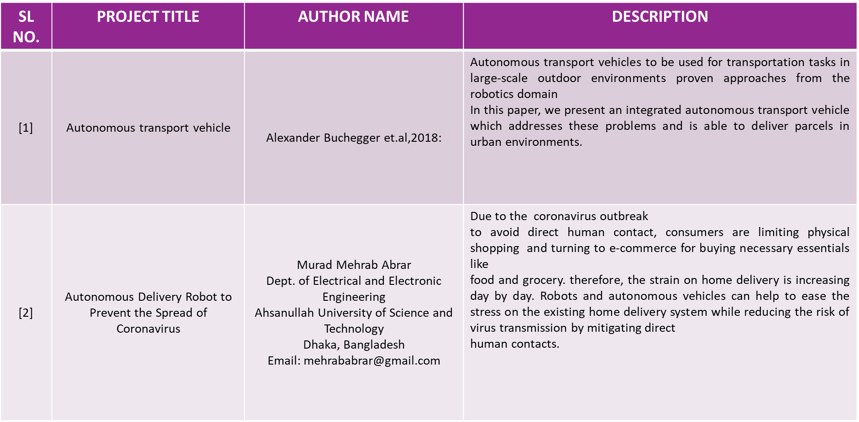
Literature Survey:

Slide 6
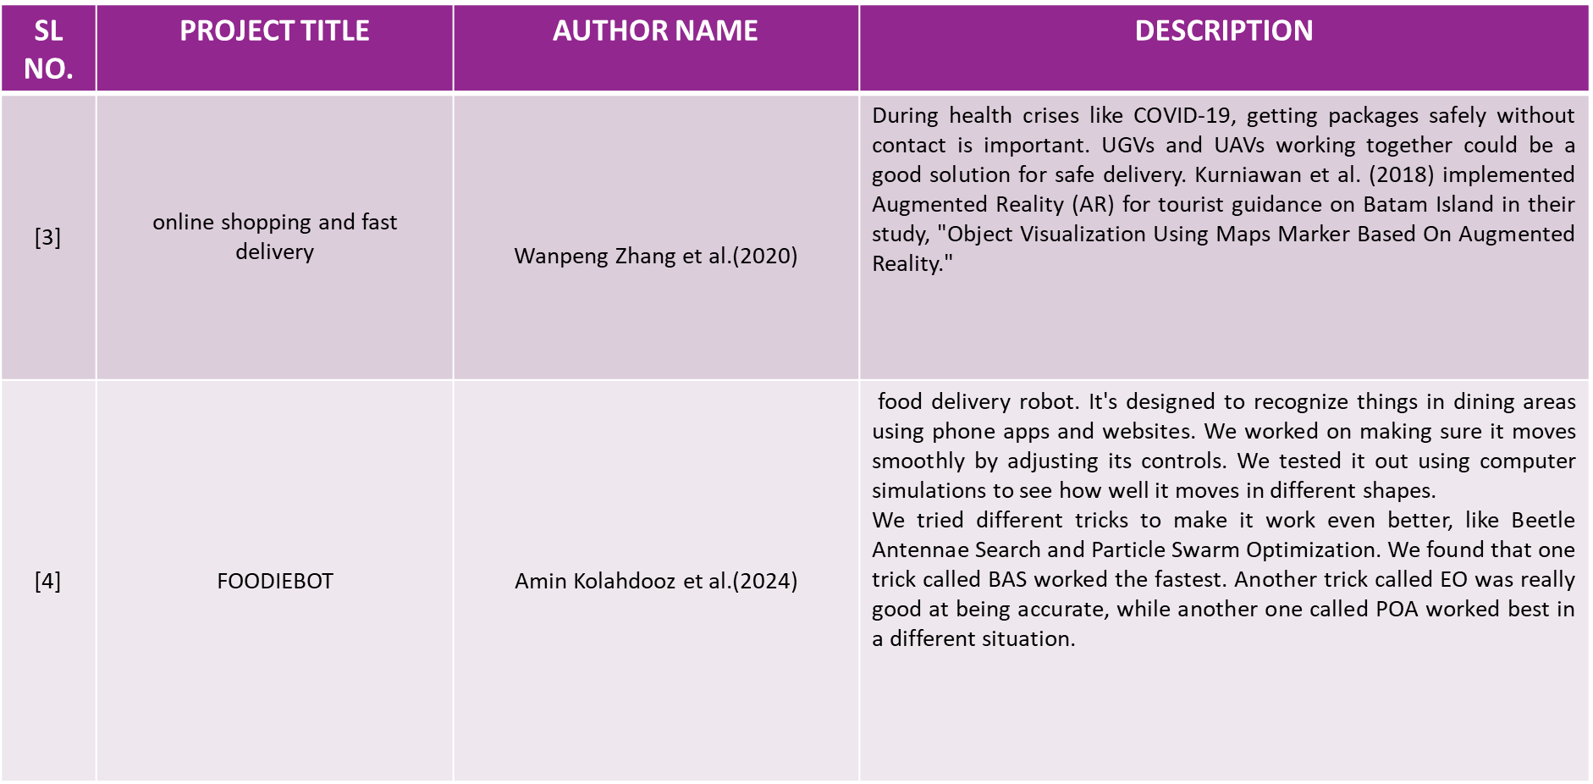

Slide 7
Problem Statement
To design and develop a robot car that capable of delivering items within campus

Slide 8
Scope of the Project :
This robot car can delivery mail/packages, food, and other essential items to various locations within the campus.
This robot car is suitable for only traveling on the plane surfaces.
This robot car is not suitable for going to different floors in building through stairs.
As the robot car works on rechargeable batteries ,if the batteries get drained, it can be recharged easily.
The robot car can handle the packages of weight up to 3.5 kgs.

Slide 9
Requirements
SOFTWARE REQUIREMENTS:
• Windows : windows7 or higher.
• Software : Arduino IDE 1.8.16 software.
• Code : sketches
HARDWARE REQUIREMENTS:
•Batteries.
• Jumper cables.
•Arduino Uno (micro-controller) & motor driver.
•Wheels and LP293D (dc motor)
•Chassis.
•Camera with mic and speaker.
•Carrier box.
•IR remote
SENSORS:
•HC-SR04 (Ultrasonic Sensor)
•IR Sensor.
•Bluetooth sensor.
•IR receiver.

Slide 10
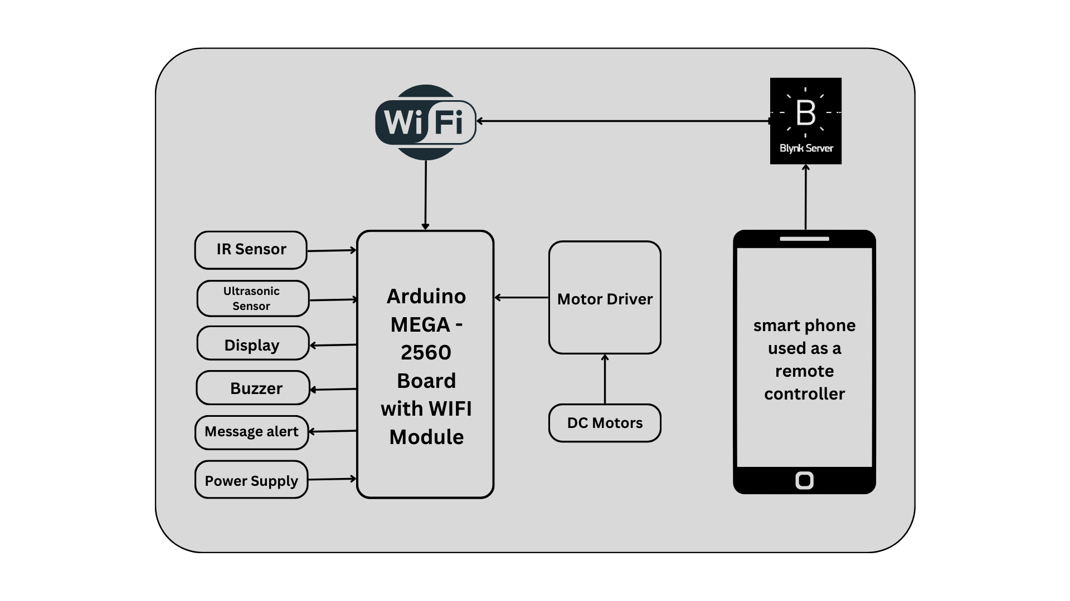
DFD DIAGRAM :

Slide 11
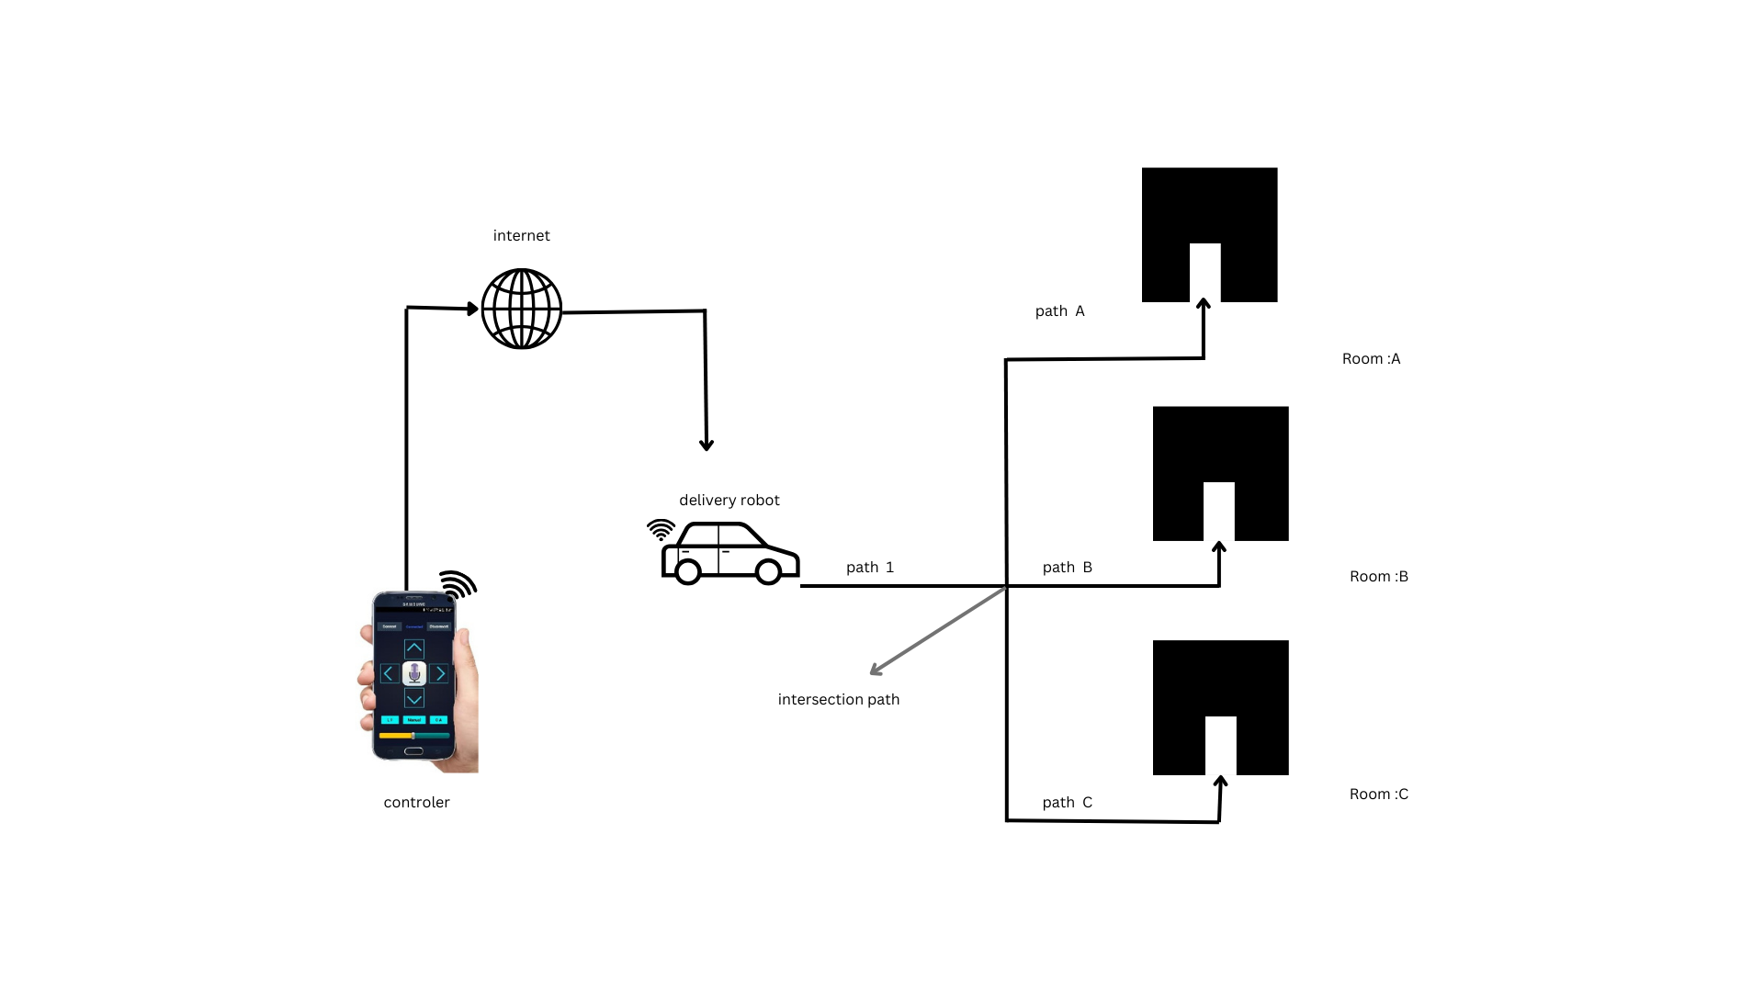
BLOCK DIAGRAM :

Slide 12
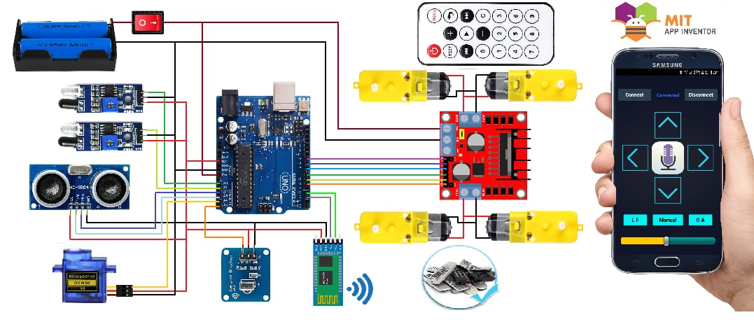
CIRCUIT DIAGRAM :

Slide 13
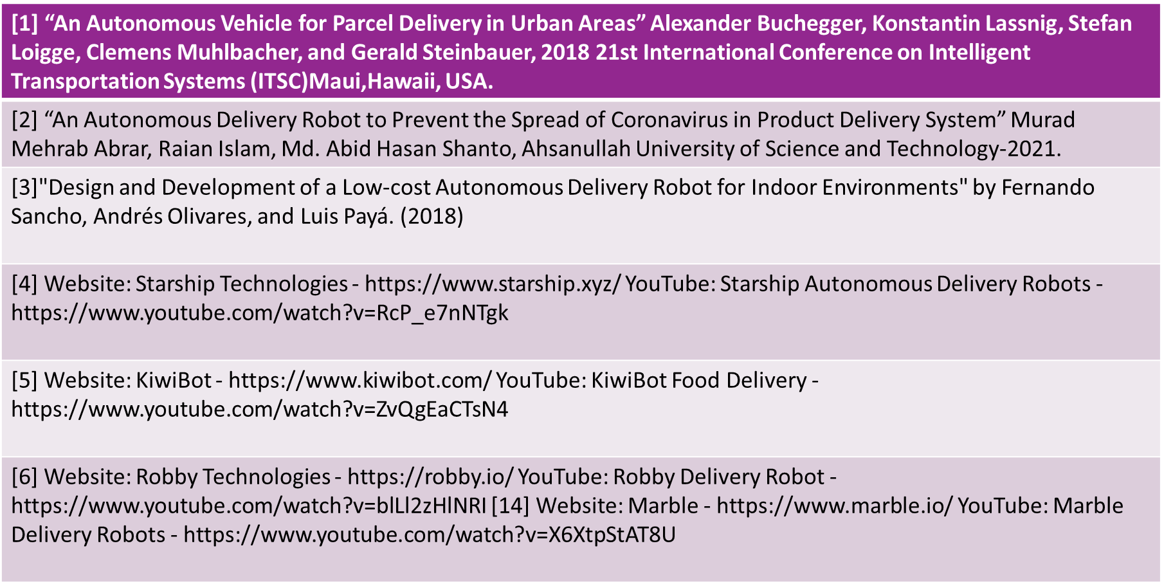
References

Slide 14
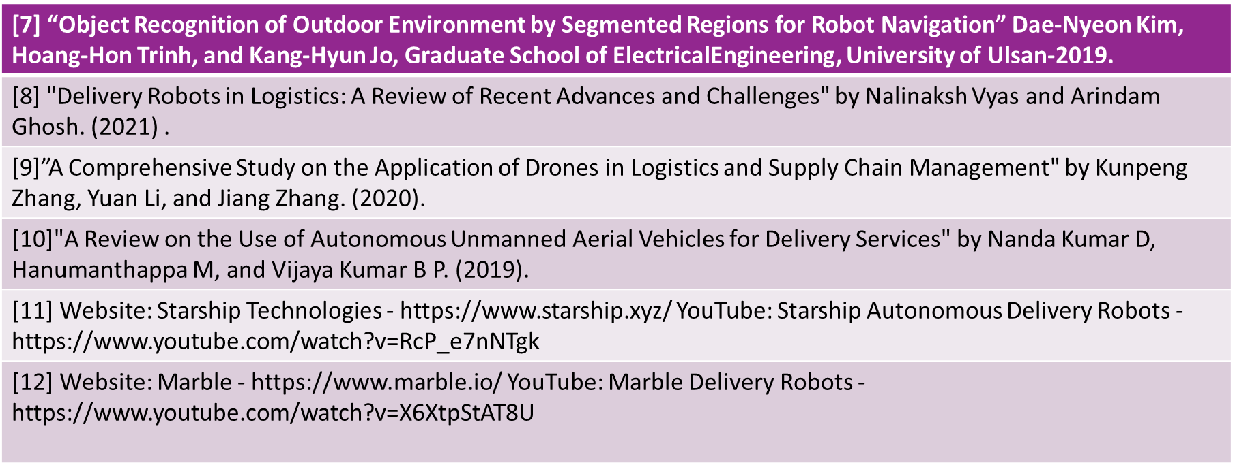

Slide 15
THANK YOU
“BATCH 29”

